Slide 1


The Low-Down on Ladder Safety:
A guide to proper portable ladder selection, use, & regulatory compliance

Slide 2
objectives
This training will ensure understanding of:
Why ladder safety matters
What regulatory obligations apply to ladder safety
How to identify an approved ladder
How to distinguish ladder types
Proper inspection, storage, and use information

Slide 3
Approved Ladder Characteristics
Approved ladders will have:
Two side rails crossed with evenly spaced rungs, cleats, or steps
  Steps must be between 10 and 14 inches apart.
  Minimum clear distance between side rails of portable ladders is 11.5 inches.
  Minimum clear distance between side rails of step ladders is 16 inches.
Labeling outlining intended use instructions and load restrictions
A weight tolerance of 4 times the intended weight load
  Extra heavy-duty type 1A, metal or plastic, must have a weight tolerance of 3.3 times the intended load.
Individual steps which can tolerate & support an individual load of 250 pounds
Steps must be knurled, corrugated, dimpled, or treated with non-skid material.

Slide 4
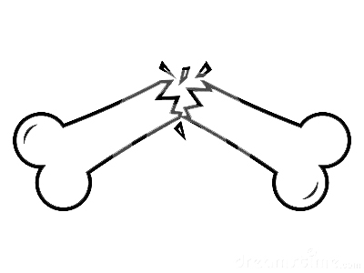

Ladder Injuries
The U.S. Consumer Product Safety Commission estimates that in one year, 65,000 individuals receive emergency room treatment because of ladder accidents. (CDC)
Any fall can be serious, and a fall from the height of even a low ladder can mean a painful and incapacitating injury.
The most common causes of
ladder-related injuries:
using the wrong ladder for the job
misusing or abusing climbing equipment.

Slide 5
Osha regulations / ANSI standards
Ladder Types:
Type III – common household use 3 – 6 feet Maximum load 200 lbs total, user plus materials
Type II – medium duty 3 – 12 feet Maximum load 225 lbs total, user plus materials
Type I – heavy duty 3 – 20 feet Maximum load 250 lbs total, user plus materials
Material Types:
Metal OSHA regulation 29 CFR 1910.26 ANSI standard ANSI A14.2-2007
Plastic/Fiberglass No OSHA regulation ANSI standard ANSI A14.5-2007
Wood OSHA regulation 29 CFR 1910.25 ANSI standard ANSI A14.1-2007

Slide 6
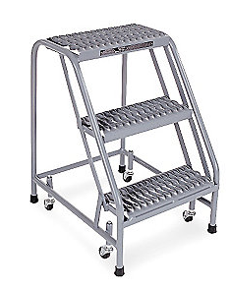

Selecting an APPROVED ladder
Rolling step ladders are often used in situations where step ladders are needed but cannot be fixed into place. Often, rolling step ladders are found in department stores, firehouses, or warehouses.
Stepladders are often
used for applications
at low or medium heights.
Ladder tops and pail
shelves can hold tools,
small parts and
paint buckets.
Sectional ladders are
designed for use mainly
by electrical, telephone,
and cable utilities. They
provide versatility where
transit, storage or access
requires short sections to
be coupled together.
Extension ladders can handle an extremely wide
range of tasks at varying elevations and are the most popular kind of long ladders.

Slide 7
Thoughtful Considerations
Things to ponder:
Location of use: Indoors vs outdoors Single location vs multiple locations
Number of users: Only 1 person 2 people
Other factors: Weight load Possible hazards Need for mobility, i.e. – wheeled vs non-wheeled Exposure to electrical current Storage locations & transportation method

Slide 8
Safe Usage
Work safely! Remember:
The top rung of a step ladder should never be used as a standing surface or step.
Ladders should be inspected by the intended operator before each use.
  Ladders with any defects or exposure to corrosive substances, oil, or electrical shock should be removed from circulation & red tagged for repair.
Only use ladders on a flat surface.
Step ladder operators should ensure legs are fully extended & spreaders are locked.
Ladders should not exceed maximum height guidelines:
  Step ladders should not exceed 20 feet in height.
  Extension ladders should not exceed 30 feet for a single section or 48 feet for two sections.
  Rolling ladders should not exceed 20 feet.

Slide 9

Proper Placement
Ensure a proper distance from the supporting structure to the base of the ladder.
The proper ratio is 1:4.
A 20 ft. ladder should be approximately 5 feet from the support structure at its base.
1 foot of distance from support for every 4 feet of ladder height

Slide 10
Knowledge Check
What are two agencies responsible for regulating occupational safety & implementing standards, including those for ladder safety?
What must be done to the steps of a ladder to meet OSHA guidelines?
True or False: labelling on the ladder should include the maximum weight tolerance for the equipment.
True or False: falls from low levels and short ladders do not result in injuries.
What are common types of materials used in ladder construction:
  Wood
  Plastic
  Metal
  Fiberglass
  All of the above
** Any Q & A or discussion needs are welcome at this time **

